Slide 1

CSE 301- DATABASE SYSTEMS
CHAPTER-1
FARHANA AKTER SUNNY
Sr. Lecturer
Notes:
The slides for this text are organized into chapters. This lecture covers Chapter 1.
Chapter 1: Introduction to Database Systems
Chapter 2: The Entity-Relationship Model
Chapter 3: The Relational Model
Chapter 4 (Part A): Relational Algebra
Chapter 4 (Part B): Relational Calculus
Chapter 5: SQL: Queries, Programming, Triggers
Chapter 6: Query-by-Example (QBE)
Chapter 7: Storing Data: Disks and Files
Chapter 8: File Organizations and Indexing
Chapter 9: Tree-Structured Indexing
Chapter 10: Hash-Based Indexing
Chapter 11: External Sorting
Chapter 12 (Part A): Evaluation of Relational Operators
Chapter 12 (Part B): Evaluation of Relational Operators: Other Techniques
Chapter 13: Introduction to Query Optimization
Chapter 14: A Typical Relational Optimizer
Chapter 15: Schema Refinement and Normal Forms
Chapter 16 (Part A): Physical Database Design
Chapter 16 (Part B): Database Tuning
Chapter 17: Security
Chapter 18: Transaction Management Overview
Chapter 19: Concurrency Control
Chapter 20: Crash Recovery
Chapter 21: Parallel and Distributed Databases
Chapter 22: Internet Databases
Chapter 23: Decision Support
Chapter 24: Data Mining
Chapter 25: Object-Database Systems
Chapter 26: Spatial Data Management
Chapter 27: Deductive Databases
Chapter 28: Additional Topics

Slide 2
REVIEW OF THE PREVIOUS CLASS

Slide 3
LEVELS OF ABSTRACTION
Physical level: describes how a record (e.g., instructor) is stored.
Logical level: describes data stored in database, and the relationships among the data.
  type instructor = record
  ID : string;
  name : string;
  dept_name : string;
  salary : integer;
        end;
View level: application programs hide details of data types. Views can also hide information (such as an employee’s salary) for security purposes.

Slide 4

VIEW OF DATA
An architecture for a database system

Slide 5
INSTANCES AND SCHEMAS
Instance:
The collection of information stored in the database at a particular moment is called an instance of the database.
Schemas:
The overall design of the database is called the database schema.
Physical Internal Schema:
The physical schema, describes the physical storage structure of the database.
Internal level is concerned with the following activities :
Storage space allocation for data and storage.
Record descriptions for storage with stored size for data items.
Record Placement.
Data compression and data encryption techniques.

Slide 6
THE CONCEPTUAL OR LOGICAL SCHEMA :
Logical schema or logical schema: The logical schema describes the structure of the whole database for a community of users. The conceptual schema describes the entities, data types, relationships, user operations and constraints and hides the details of physical storage structure.
The conceptual level is concerned with the following activities :
All entities, their attributes and their relationships.
Constraint on the data.
Semantic information about the data.
Security information.
Checks to retain data consistency and integrity.

Slide 7
EXTERNAL SCHEMA:
Each external schema describes the part of the database that a particular user group is interested in and hides the rest of the database from that user group.

Slide 8
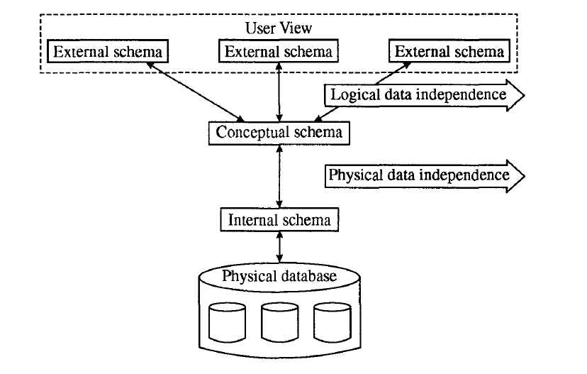

Slide 9
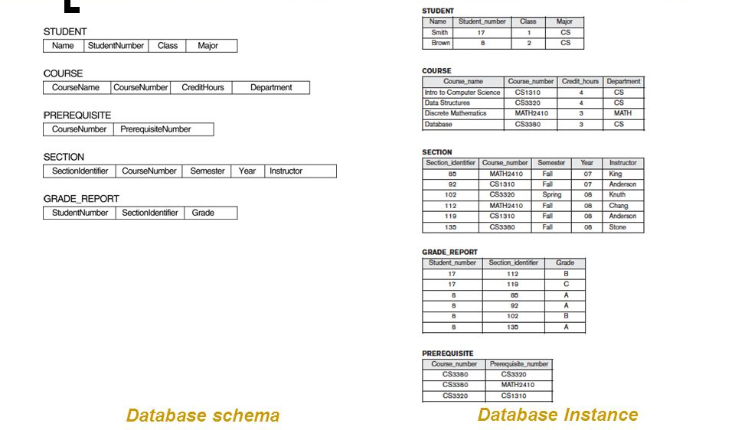
Instances and Schemas

Slide 10
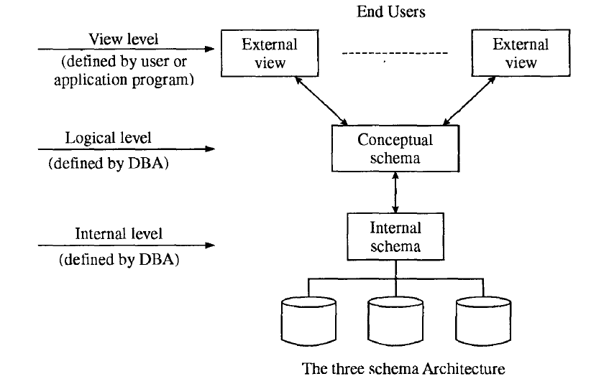
THE CONCEPTUAL OR LOGICAL SCHEMA

Slide 11
DATA MODELS
A collection of tools for describing
  Data
  Data relationships
  Data semantics
  Data constraints
Relational model
Entity-Relationship data model (mainly for database design)
Object-based data models (Object-oriented and Object-relational)
Semi structured data model (XML)
Other older models:
  Network model
  Hierarchical model

Slide 12
THE ENTITY-RELATIONSHIP MODEL
The E-R data model is based on a perception of a real world that consists of a collection of basic objects called entities and relationship among these objects.
The overall logical structure of a database can be represented graphically by E-R diagram. The E-R diagram is build up from the following components.
Rectangle: which represent entity sets
Ellipses: which represent attributes
Diamonds: which represent relationship among entity sets.
Lines: which link attributes to entity sets and entity sets to relationships.
Double ellipses : which represent multivalued attributes.
Dashed Ellipses : which denote derived attributes.
Double Lines : which represent total participates of an entity in a relationship set.
Double Rectangle : which represent weak entity sets.

Slide 13
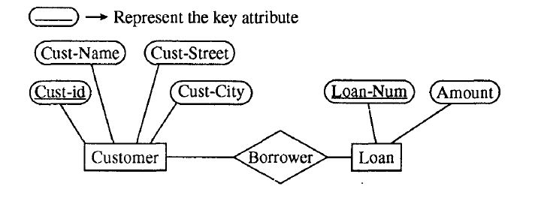
THE ENTITY-RELATIONSHIP MODEL

Slide 14
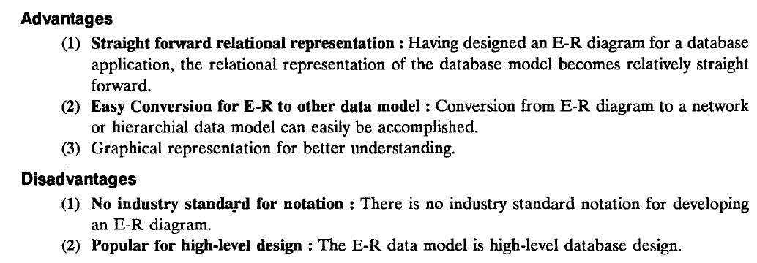
THE ENTITY-RELATIONSHIP MODEL

Slide 15
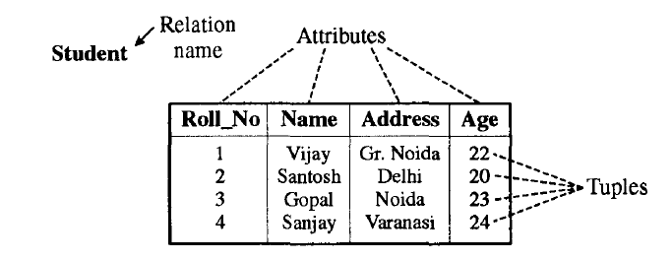
RELATIONAL MODEL
The relational model uses a collection of tables to represent both data and the relationships among those data.
A table is a collection of rows and columns. Each column has a unique name. Each row in the table represents a collection of related data values. In the relational model, a row is called a tuple, a column header is called an attribute and the table is called a relation.

Slide 16
ADVANTAGES OF RELATIONAL MODEL
Simplicity: A relational data model is even simpler than hierarchical and network models. It frees the designers from the actual physical data storage details, thereby allowing them to concentrate on the logical view of the database.
Structural independence : The relational data model does not depend on the navigational data access system. Changes in the database structure do not affect the data access.
Ease of design, implementation, maintenance and uses.
Flexible and powerful query capability.

Slide 17
DISADVANTAGES OF RELATIONAL MODEL
Hardware overheads: The relational data models need more powerful computing hardware and data storage devices to perform RDBMS-assigned tasks.
Easy to design capability leading to bad design.

Slide 18

A SAMPLE RELATIONAL DATABASE

Slide 19
TYPES OF DATABASE SYSTEMS
The DMBS can be classified according to the number of users, the database site locations.
On the basis of the number of users :
    Single-user DBMS
    Multi-user DBMS
On the basis of the site location :
    Centralized DBMS
    Distributed DBMS
    Parallel DBMS
    Client/Server DBMS

Slide 20
CENTRALIZED DATABASE SYSTEM
The centralized database system consists of a single processor together with its associated data storage devices and other peripherals. It is physically confined to a single location. The management of the system and its data are controlled centrally form anyone or central site.
A DBMS is centralized if the data is stored at a single computer site. A centralized DBMS can support multiple users, but the DBMS and the database themselves reside totally at a single computer site.

Slide 21
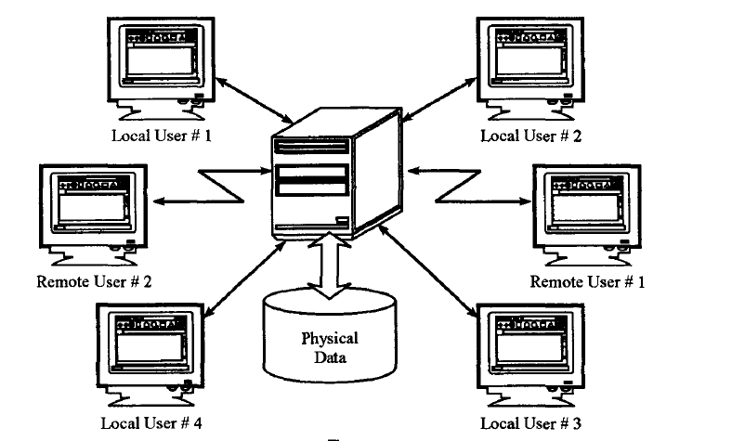
CENTRALIZED DATABASE SYSTEM

Slide 22
DISTRIBUTED DATABASE SYSTEM
A distributed database is a collection of multiple logically interrelated database distributed over a Computer Network.
A distributed database management system is a software system that manages a distributed database while making the distribution transparent to the user.
In distributed database system, data is distributed across a variety of different databases.
These are managed by a variety of different DBMS software's running on a variety of different computing machines supported by a variety of different operating systems. These machines are distributed geographically and connected together by a variety of communication networks. In distributed database system, one application can operate on data that is distributed geographically on different machines.

Slide 23
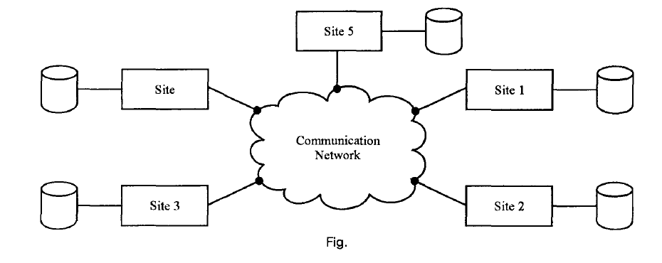
DISTRIBUTED DATABASE SYSTEM

Slide 24
PARALLEL DATABASE SYSTEM
Parallel database systems architecture consists of a multiple CPUs and data storage disks in parallel. Hence, they improve processing and input/output speeds. Parallel database systems are used in the applications that have to query extremely large databases or that have to process an extremely large number of transactions per second.
Several different architectures can be used for parallel database systems, which are as follows:
Shared Memory: All the processors share a common memory.
Shared data storage disk: All the processors share a common set of disks. Shared disk systems are sometimes called clusters.
Independent Resources : The processors share neither a common memory nor common disk.
Hierarchical: This model is a hybrid of the preceding three architectures.

Slide 25
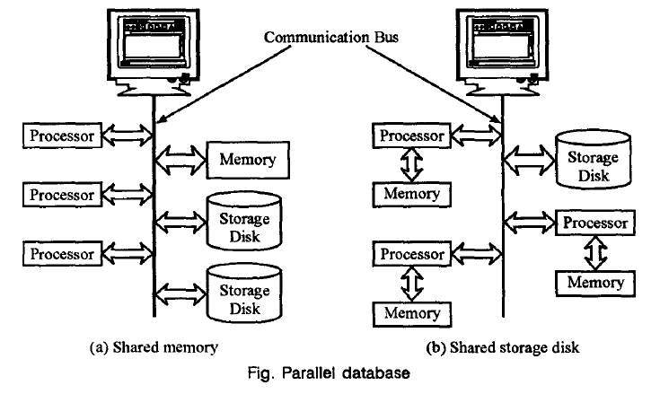
PARALLEL DATABASE SYSTEM

Slide 26
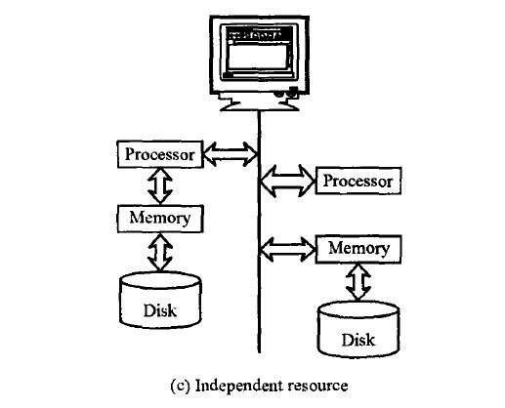
PARALLEL DATABASE SYSTEM

Slide 27
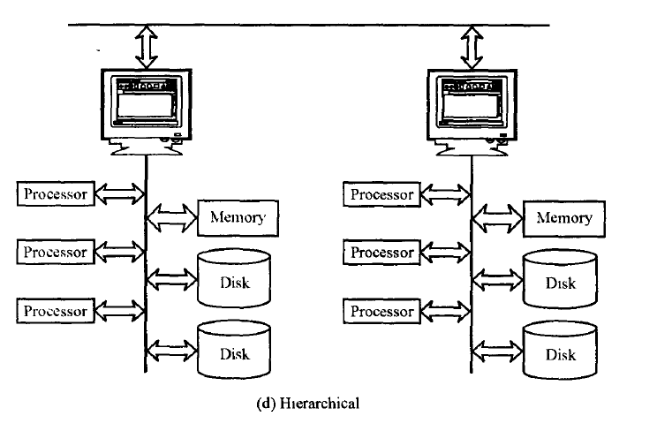
PARALLEL DATABASE SYSTEM

Slide 28
DIFFERENCES
Parallel Databases
• Machines are physically close to each other, e.g., same server room
• Machines connects with dedicated high-speed LANs and switches
• Communication cost is assumed to be small
• Can shared-memory, shared-disk, or shared-nothing architecture
Distributed Databases
• Machines can far from each other, e.g., in different continent
• Can be connected using public-purpose network, e.g., Internet
• Communication cost and problems cannot be ignored
• Usually shared-nothing architecture

Slide 29
CLIENT/SERVER DATABASE SYSTEM
Client/Server architecture of database system has two logical components namely client and server. Clients are generally personal computer or workstations whereas server is large workstations.
The applications and tools of DBMS run on one or more client platforms, while the DBMS software reside on the sever. The server computer is called backend and the client's computer is called frontend.
These server and client computers are connected via a computer network. The applications and tools act as clients of the DBMS, making requests for its services.

Slide 30
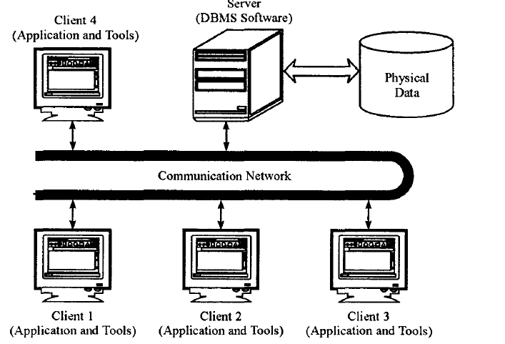
CLIENT/SERVER DATABASE SYSTEM

Slide 31
ADVANTAGES OF CLIENT/SERVER DATABASE SYSTEM
Client/server environment facilitates in more productive work by the users and making better use of existing data.
Client/server database system is more flexible as compared to the centralized system.
A single database (on server) can be shared across several distinct client (application) systems.
Client/server architecture provide a better DBMS performance.
Client/server system has less expensive platforms to support applications that had previously been running only on mainframe computers.

Slide 32
DISADVANTAGES OF CLIENT/SERVER DATABASE SYSTEM
Labor or programming cost is high in client/server environments, particularly in initial phases.
There is a lack of management tools for performance monitoring and tuning and security control, for the DBMS, client and operating systems and networking environments.

Slide 33
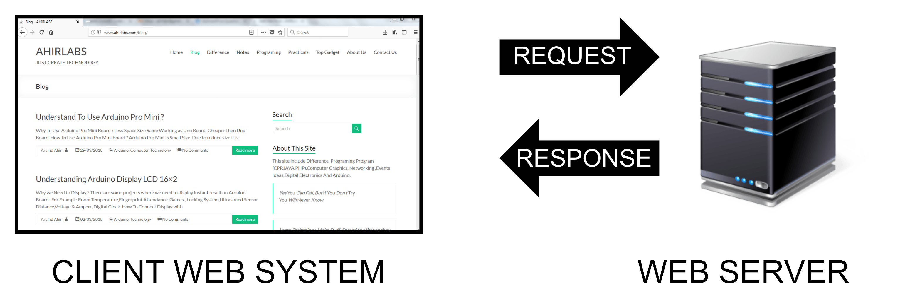
TWO-TIER CLIENT-SERVER ARCHITECTURE

Slide 34
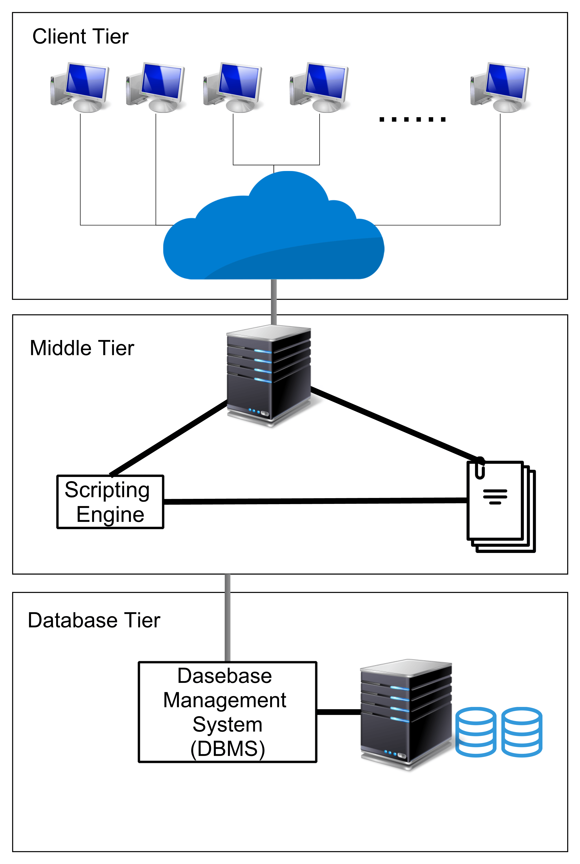
3-TIER ARCHITECTURE

Slide 35
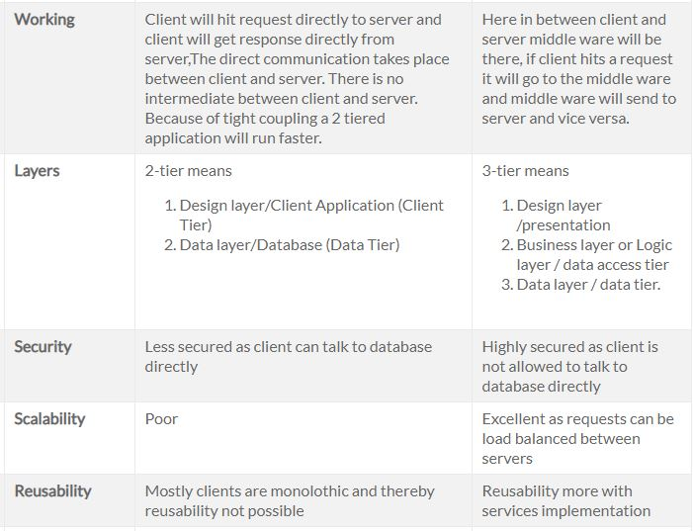
DIFFERENCES BETWEEN 2 tier & 3 tier ARCHITECTURE

Slide 36
3 TIER ADVANTAGES & DISADVANTAGES
Advantages of 3-tier architecture
Better Re-usability.
Improve Data Integrity.
Improved Security – Client is not direct access to database.
Forced separation of user interface logic and business logic.
Business logic sits on small number of centralized machines (may be just one).
Easy to maintain, to manage, to scale, loosely coupled etc
Disadvantages of 3-tier architecture
Increase Complexity/Effort

Slide 37
DISCUSS WITH YOUR LEARNING PARTNER.
What you have learn from this lecture?

